Slide 1

CTDS (303105104)
Unit :1-Introduction to C Language.
Presented by:
Prof. Henilkumar Suthar.
Assistant Professor.
CSE- PIT

Slide 2
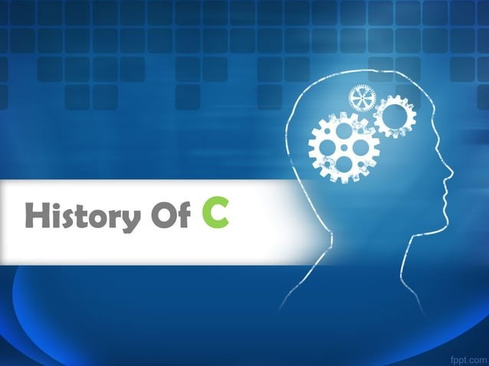

Slide 3
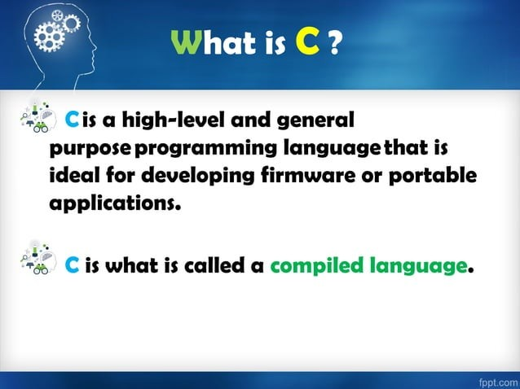

Slide 4
Why to Learn C Programming?
C programming language is a MUST for students and working professionals to become a great Software Engineer specially when they are working in Software Development Domain. Following are the key advantages of learning C Programming:
Easy to learn
Structured language
It produces efficient programs
It can handle low-level activities
It can be compiled on a variety of computer platforms

Slide 5
Facts about C
C was invented to write an operating system called UNIX.
C is a successor of B language which was introduced around the early 1970s.
The language was formalized in 1988 by the American National Standard Institute (ANSI).
The UNIX OS was totally written in C.
Today C is the most widely used and popular System Programming Language.
Most of the state-of-the-art software have been implemented using C.
Today's most popular Linux OS and RDBMS MySQL have been written in C.

Slide 6
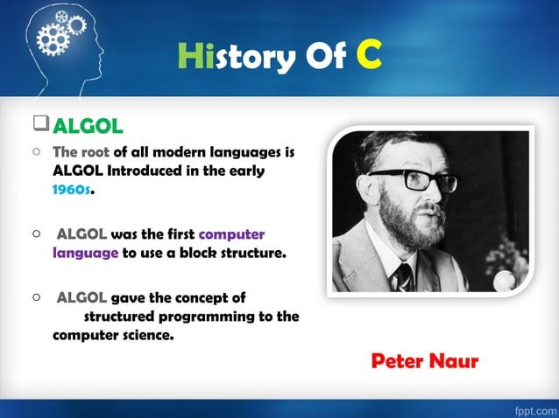

Slide 7
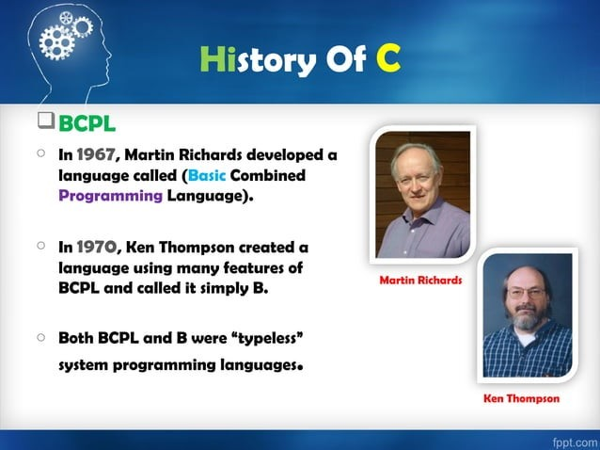

Slide 8
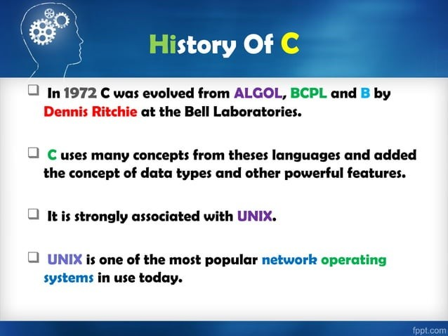

Slide 9
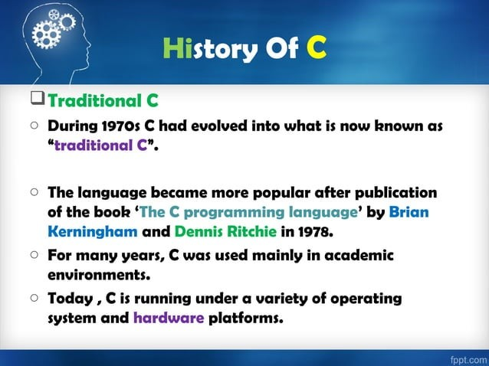

Slide 10
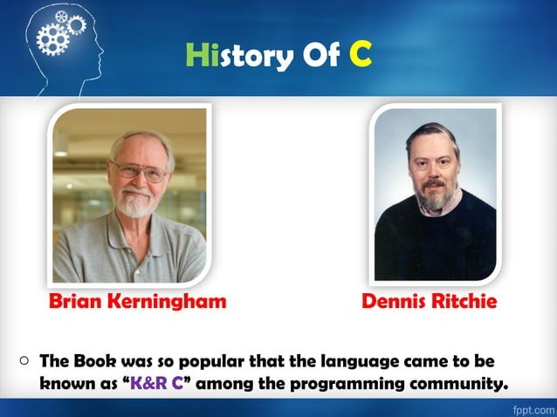

Slide 11
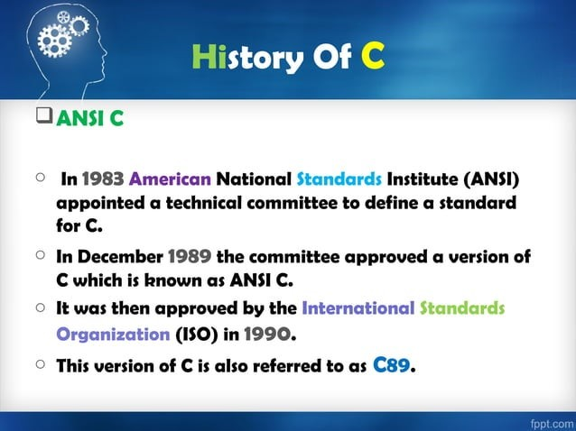

Slide 12
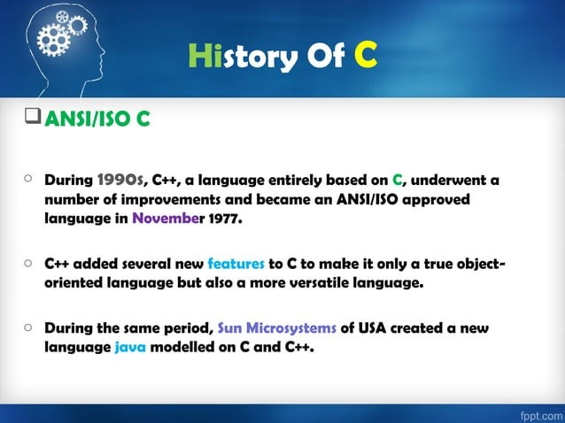

Slide 13
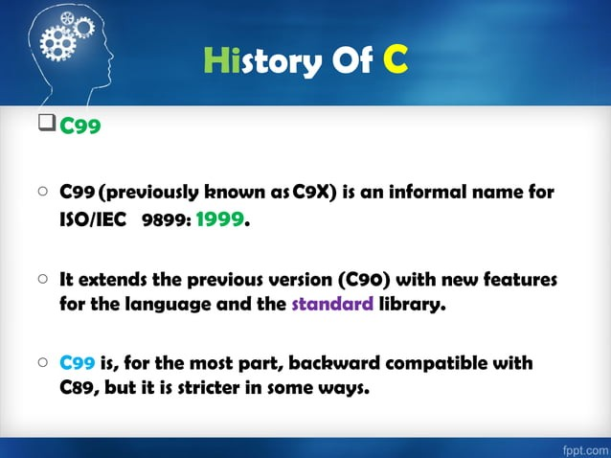

Slide 14
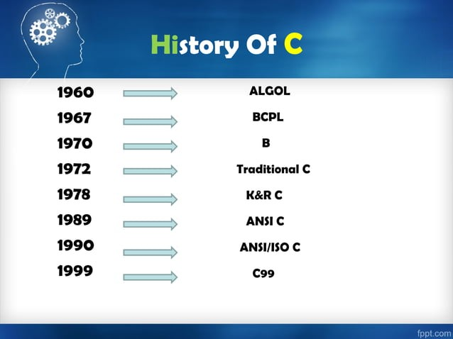

Slide 15
Structure of C Language.
There are 6 basic Section responsible for the proper execution of a program.
1. Documentation section.
2. Preprocessor section/ Link section.
3. Definition section.
4. Global declaration section.
5. Main() section.
6. Sub program Section.

Slide 16
Structure of C Language.
Documentation section:
This section Consist of the description of the program. The name of the program, and the creation date and time of the program.
// Description, name of the program, programmer name, date, time.
Preprocessor Section:
All the header files of the program will be declared in the preprocessor section of the program. Header files help us to access other’s improved code into our code. A copy of these multiple files is inserted into our program before the process of compilation.
#include<stdio.h>
#include<math.h>

Slide 17
Structure of C Language.
Definition section:
Preprocessors are the programs that process our source code before the process of compilation. There are multiple steps which are involved in the writing and execution of the program. Preprocessor directives start with the ‘#’ symbol. The #define preprocessor is used to create a constant throughout the program. Whenever this name is encountered by the compiler, it is replaced by the actual piece of defined code.
Example: #define long long ll
Global Declaration
The global declaration section contains global variables, function declaration, and static variables. Variables and functions which are declared in this scope can be used anywhere in the program.
Example:
int num = 18;

Slide 18
Structure of C Language.
Main() Function
Every C program must have a main function. The main() function of the program is written in this section. Operations like declaration and execution are performed inside the curly braces of the main program. The return type of the main() function can be int as well as void too. void() main tells the compiler that the program will not return any value. The int main() tells the compiler that the program will return an integer value.
Example:
void main()

Slide 19
Structure of C Language.
Sub Programs:
User-defined functions are called in this section of the program. The control of the program is shifted to the called function whenever they are called from the main or outside the main() function. These are specified as per the requirements of the programmer.
Example:
int sum(int x, int y)
{ return x+y; }

Slide 20
